Slide 1
Art in the Library Transforming the Library through Donor Involvement ALADN 2013 – Pittsburgh
Dr. Shirley Hallblade, Dean of the Library
Christina Levine, Director of Development
University of North Florida

Slide 2
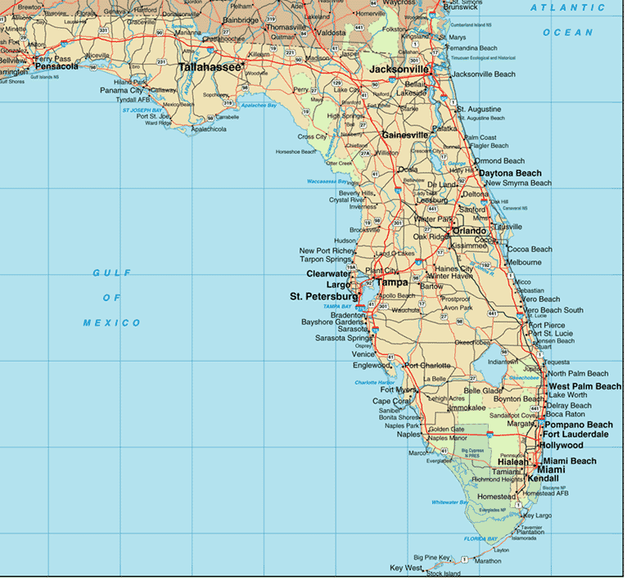
Where is Jacksonville ?

Slide 3
University of North Florida
UNF established 1972
The campus
10,400 FTE (16,000+ students)
5 colleges
One of 11 Florida state universities

Slide 4
Thomas G. Carpenter Library
Named for founding UNF president
Staff size
Collections
Local and regional history / Archives
e-Resources
Implemented EDS web-scale discovery
“OneSearch”

Slide 5
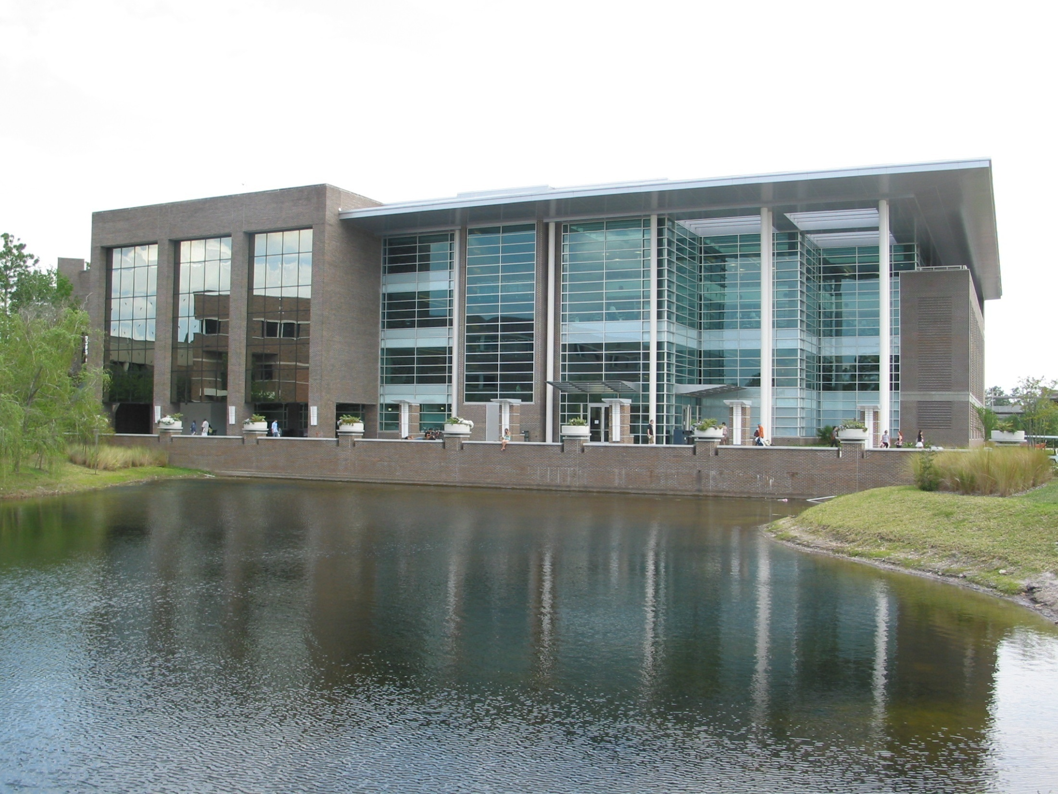
Thomas G. Carpenter Library
Shirley Hallblade, Ph.D

Slide 6
Context
Library building
Original construction in 1980
Expansion and renovation – 2004/2005
Increased size to 200,000 sq. ft. on 4 floors
New dean - Spring 2006 – major goals
Increase visibility of the library
Establish external fund-raising program

Slide 7
Library Development Program
Essentially nonexistent
Gifts and donations
Director of Development
Dean’s Leadership Council
(donor advisory boards or friends groups)
UNF campaign – “Power of Transformation”

Slide 8
Art in the Library Project Vision and Focus
Building ambiance
Art appreciation and study
Library visibility
Community outreach / University campaign
Northeast Florida regional artists / UNF faculty
Donations from artists or collectors

Slide 9
Project Implementation
First Steps
Dean and development director
Volunteer project coordinator
Volunteer committee from Leadership Council
Early Successes
Coincidental donors / collectors
Interest and commitment

Slide 10
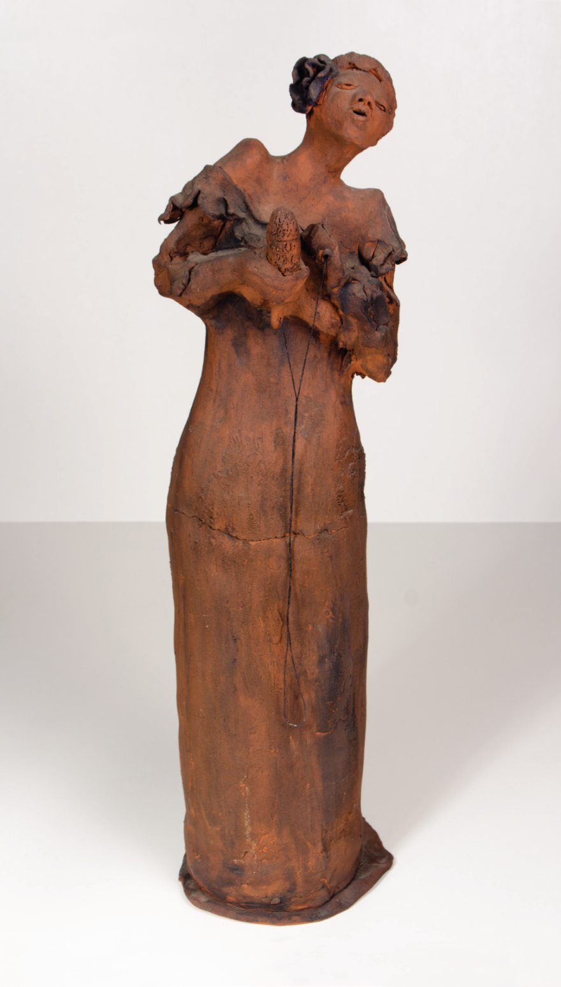
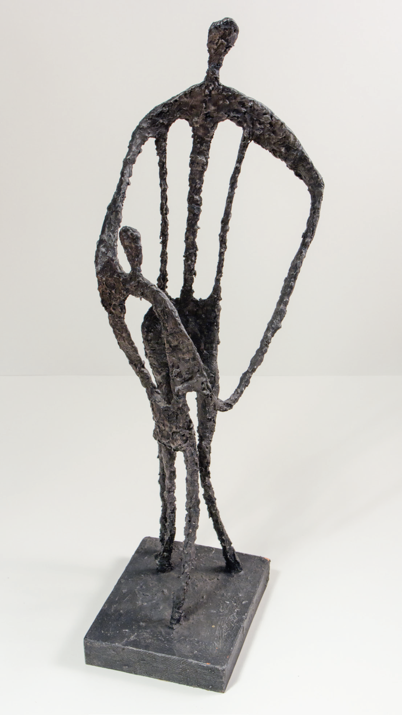

Slide 11
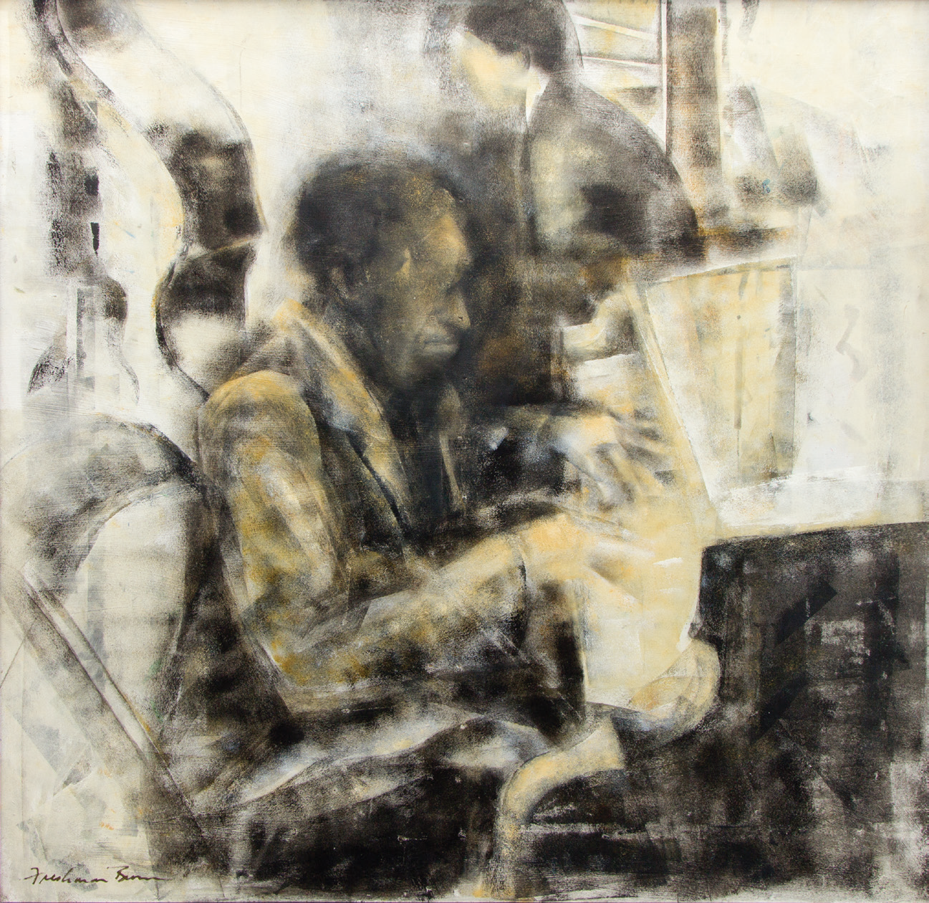

Slide 12
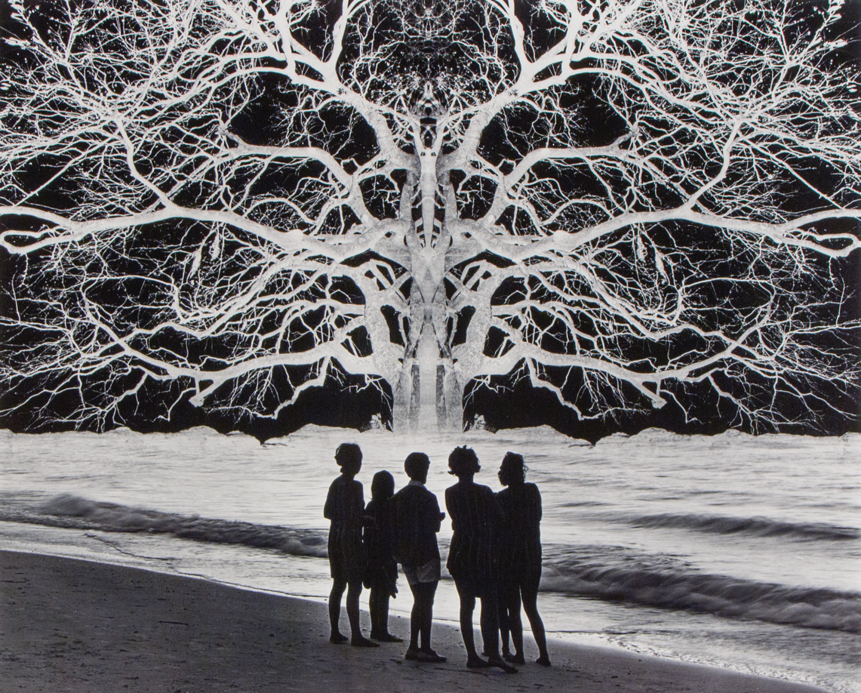

Slide 13
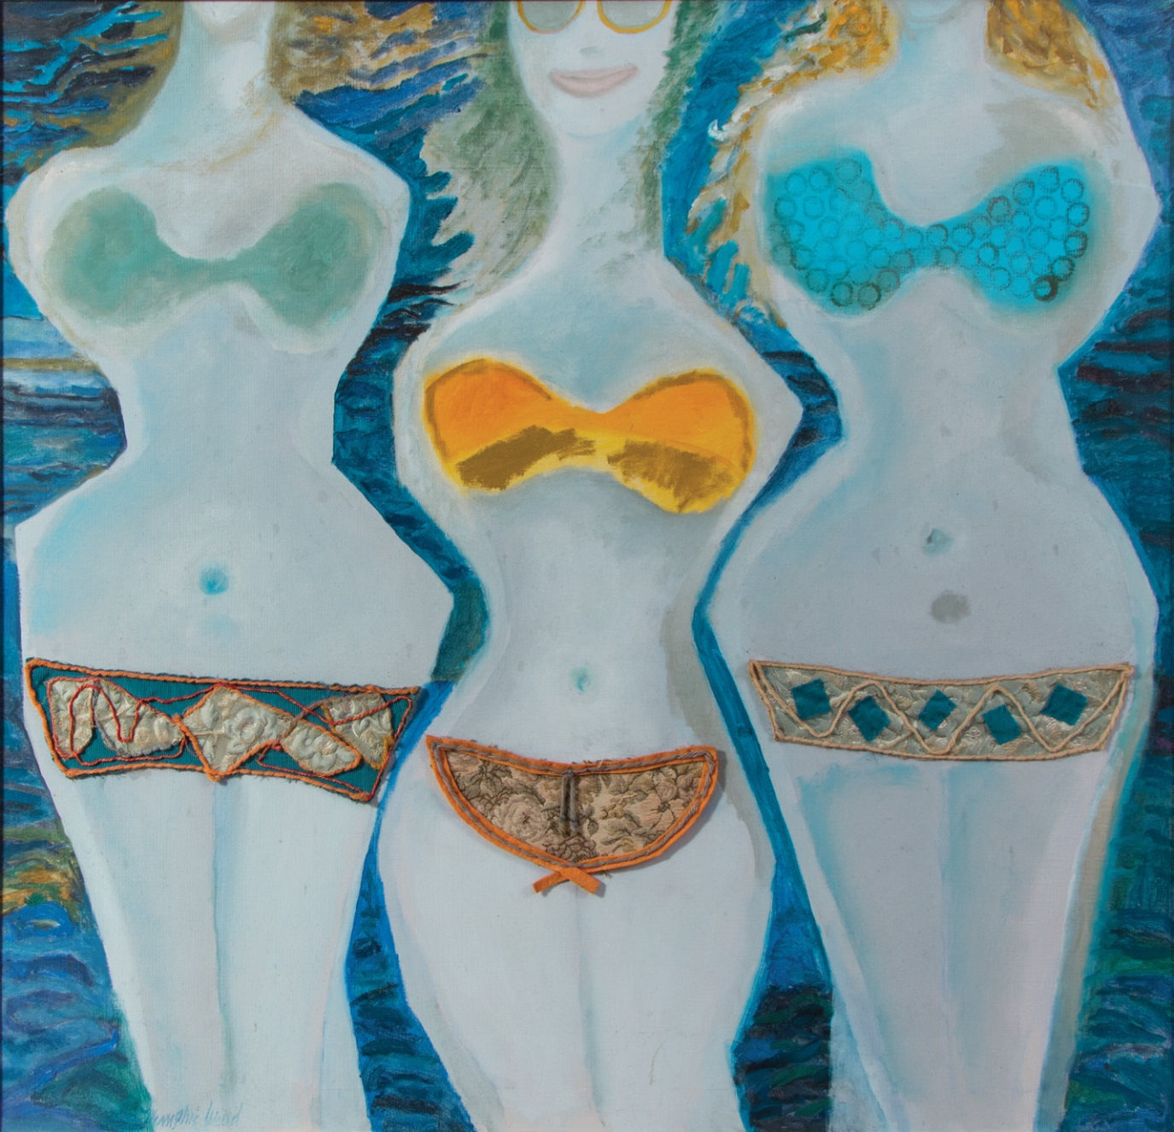

Slide 14
Outreach and Collaboration
Local/regional art community
Galleries, festivals, artist studios, art organizations
Campus Art + Design department
Other UNF faculty and staff
Donors and donor prospects

Slide 15
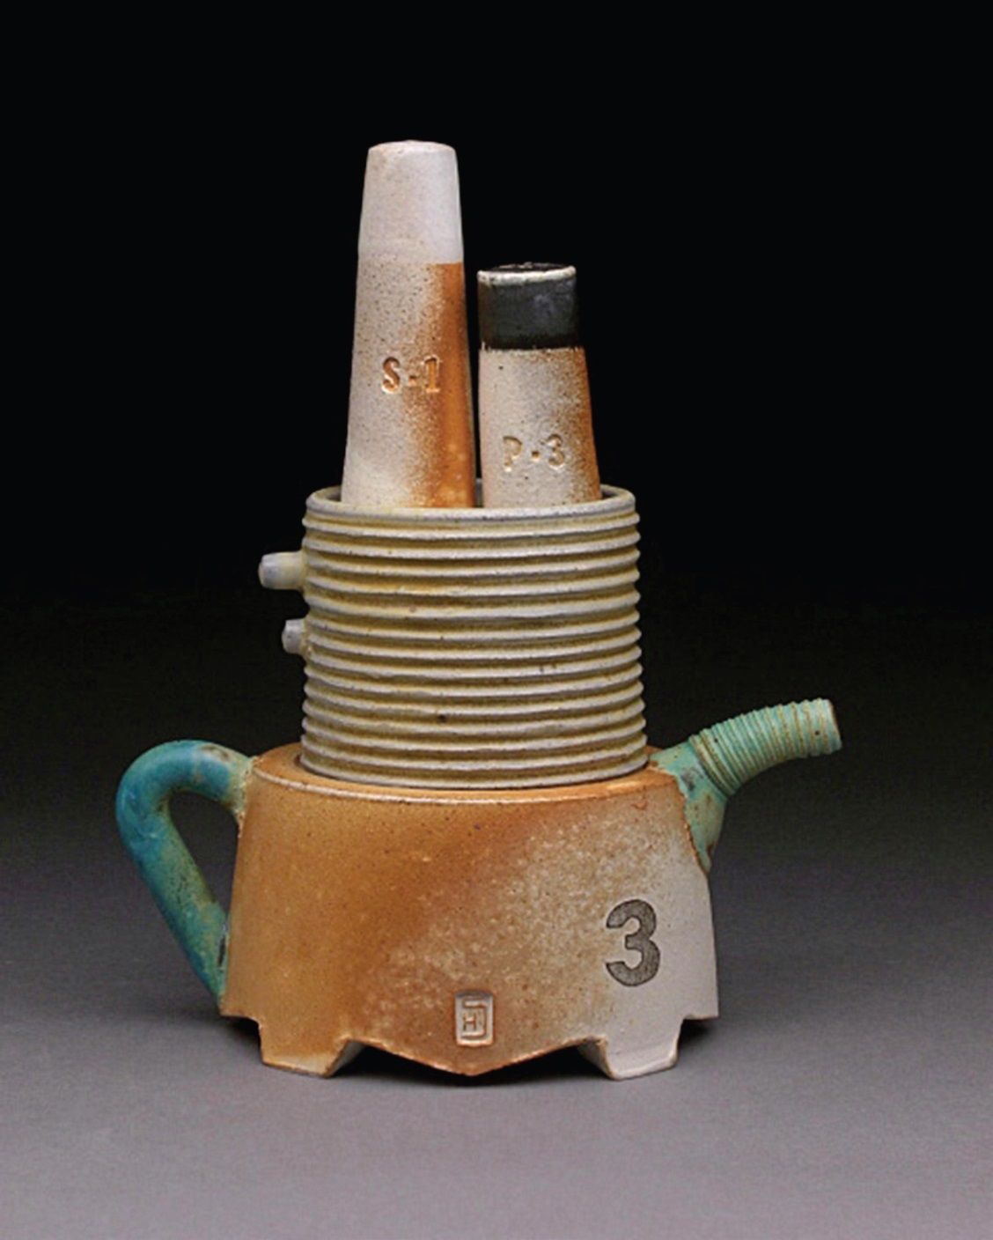

Slide 16
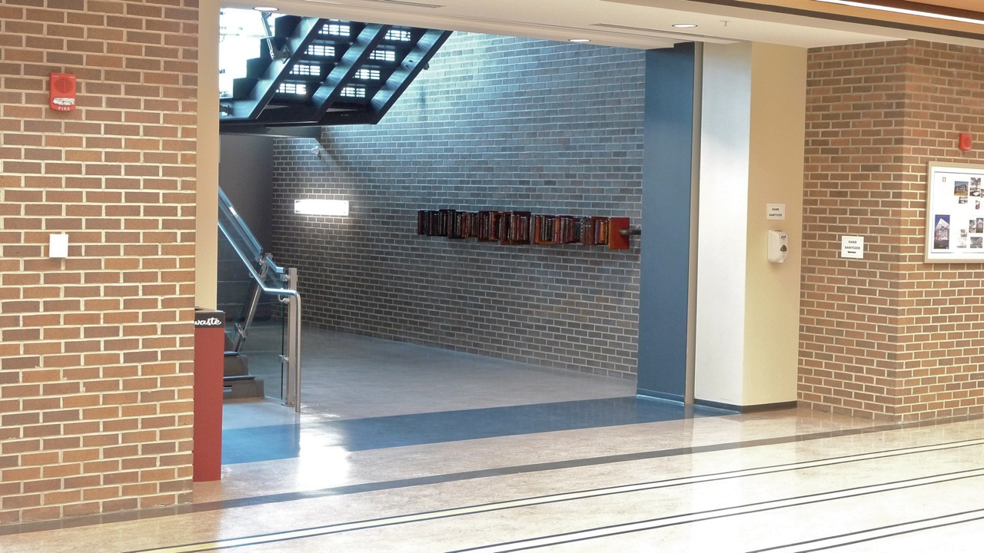

Slide 17
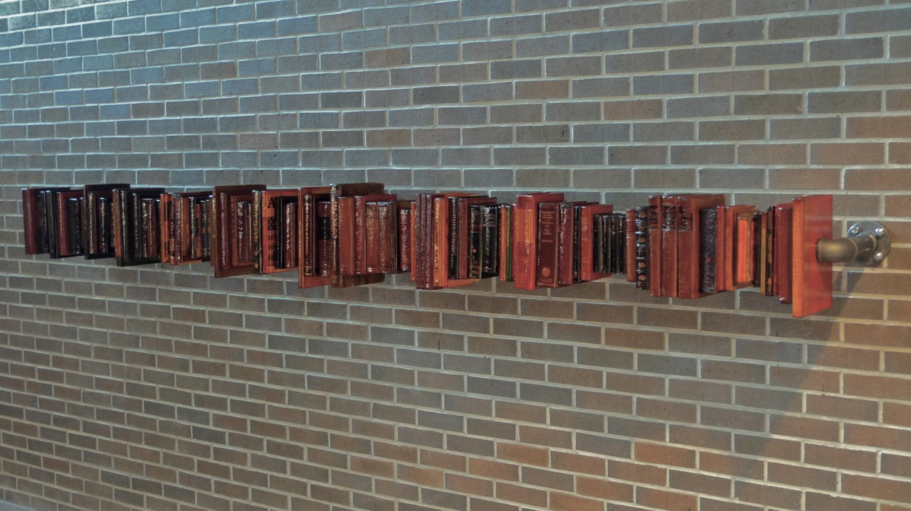

Slide 18
Promotional Events
Gallery show/art class – Charles Fazzino
Created collaborative work with 40 local children
Piece donated to the Library
Project kick-off – “An Artful Evening”
Gallery show – “Renoir and the Impressionists”
Library benefit (% of sales)
Presentation to UNF Art + Design Faculty

Slide 19
Publicity
Arbus Magazine
Times-Union article
UNF Journal
Alumni Newsletter
Inside UNF

Slide 20
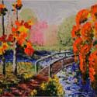
 | R Roberts Gallery Presents Renoir & the Impressionists Date: Wednesday, September 29, 2010 Time: 6:00 p.m. – 8:00 p.m. Location: R Roberts Gallery Cost: Free R Roberts Gallery presents Renoir & the Impressionists on Wednesday, September 29th from 6:00 p.m. - 8:00 p.m. This will be an evening of cocktails and art to benefit the Thomas G. Carpenter Library’s Art in the Library Program at the University of North Florida. A rare collection of paintings, drawings, etchings and lithographs by Renoir, Manet, Cezanne & Pissarro will be available for purchase. For more information or to RSVP please contact the R Roberts Gallery at 388-1188.

Slide 21
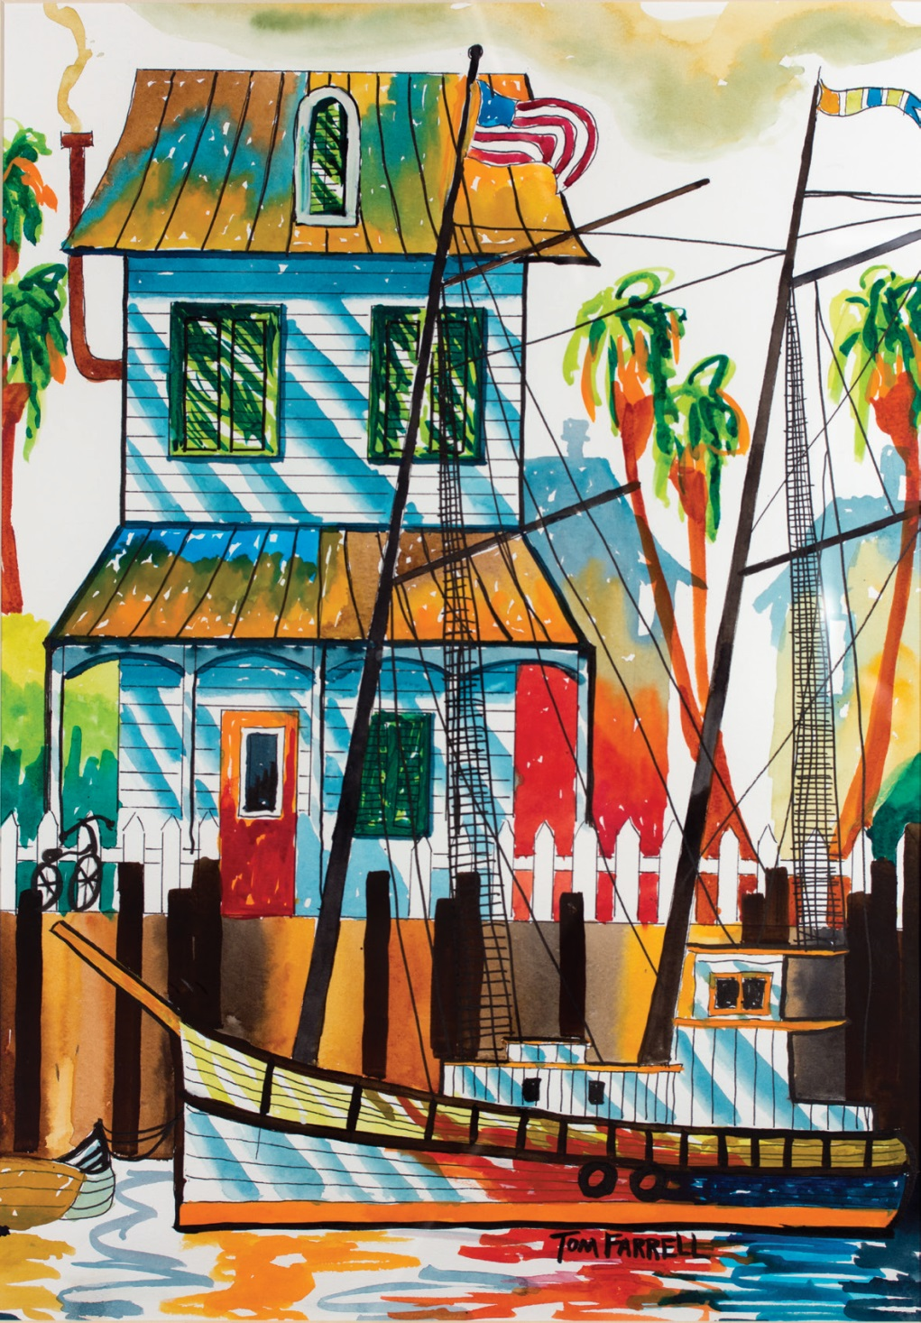
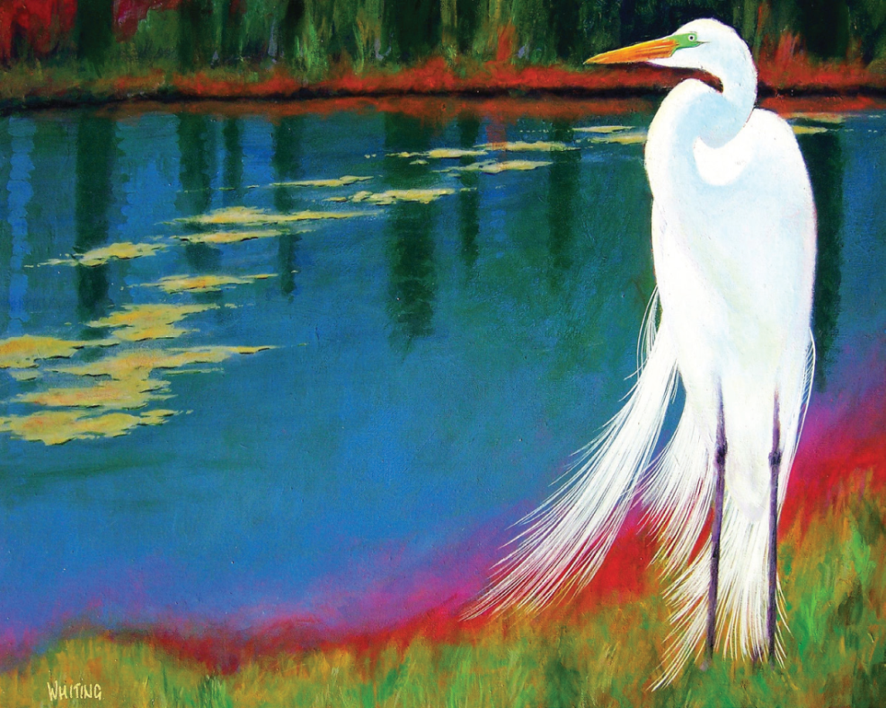

Slide 22
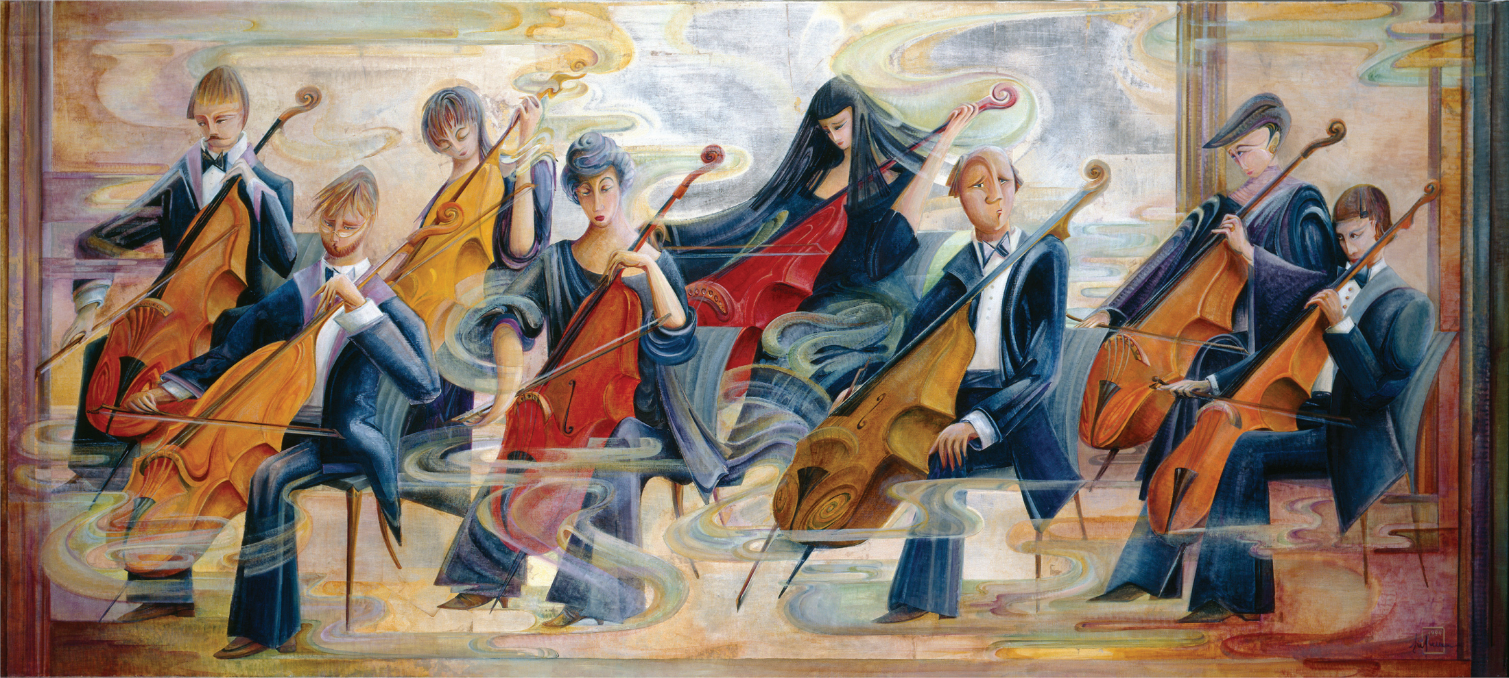

Slide 23
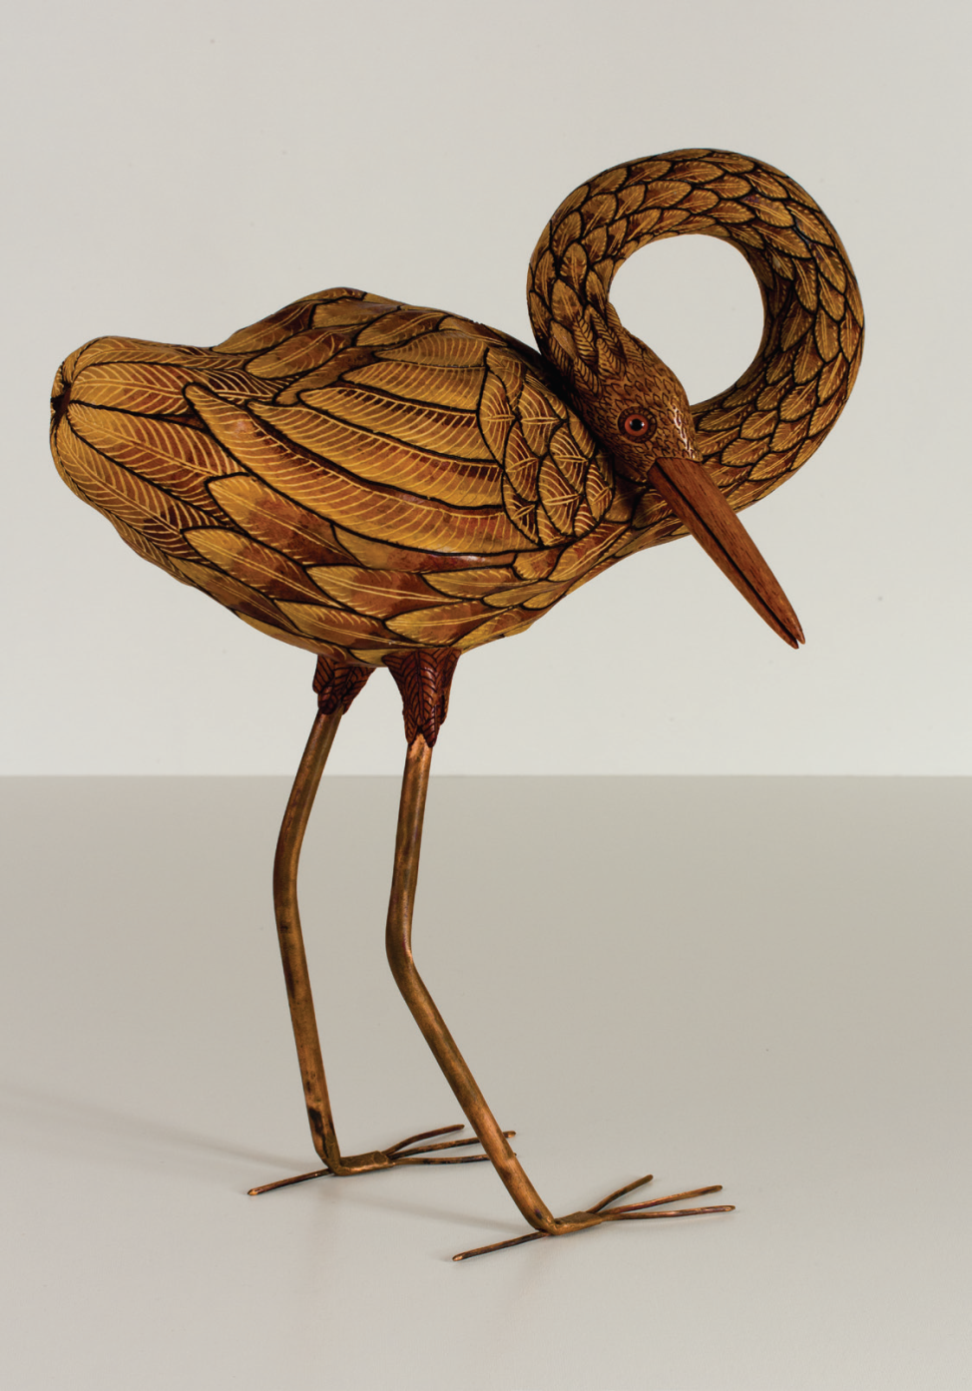
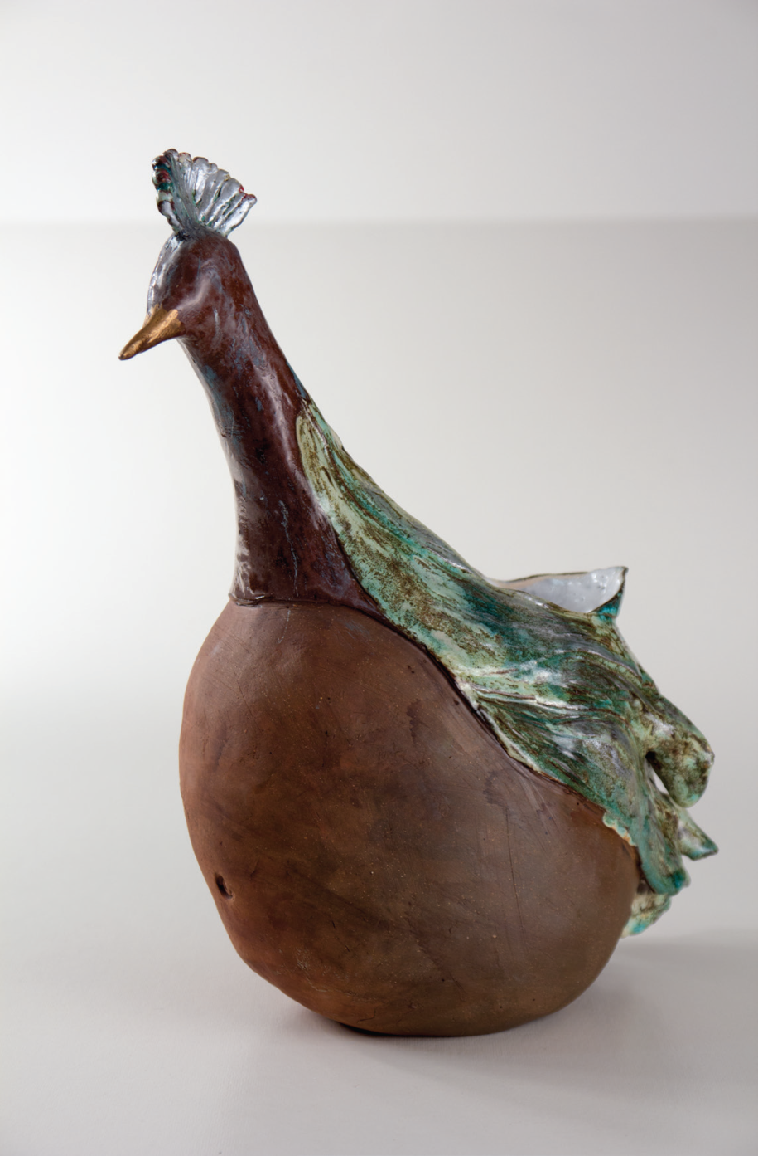

Slide 24
Related Developments
Librarian Liaison for Art
– Curator role
LibGuides / Campus Guides
Digital Commons
Technical support from library staff & students
Photography
Digitization
Documentation

Slide 25
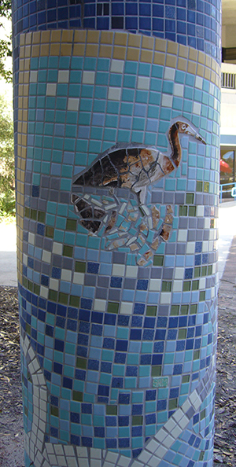
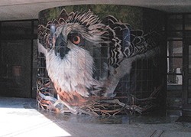
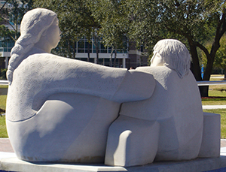
Art on Campus

Slide 26
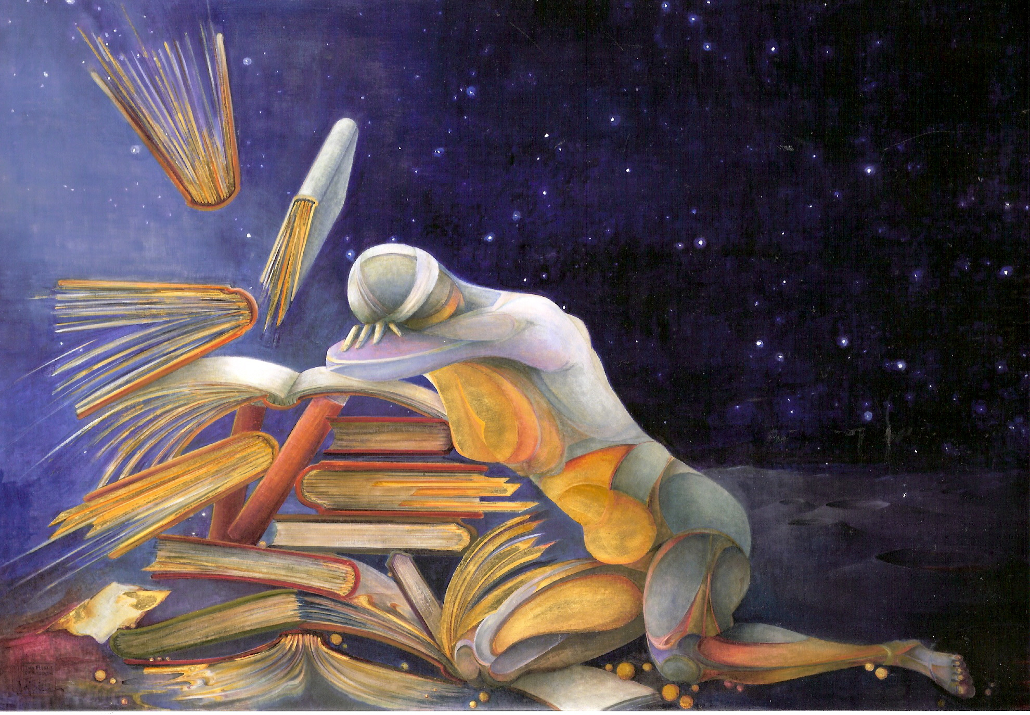

Slide 27
Outcomes
Number of donated works of art
Value of gifts-in-kind
Cash donations for project support
Initial transfer from Dean’s Excellence Fund
Additional gifts
Recognition
Library, donors, volunteers, artists, staff

Slide 28
Leveraging the Collection
Campus resource
Support from Art + Design department chair
Participating faculty artists
Class assignments
Community outreach
Library tours / Prospective donors
Giving opportunities

Slide 29
Project Completion
Catalog of the collection
Art in the Library Celebration
June 7, 2013
Self-guided walking tour

Slide 30
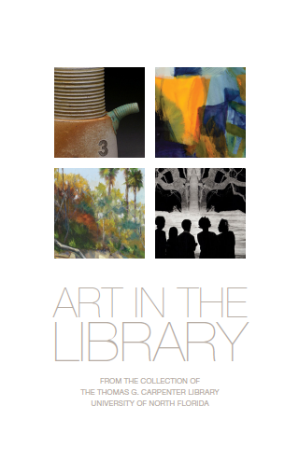

Slide 31
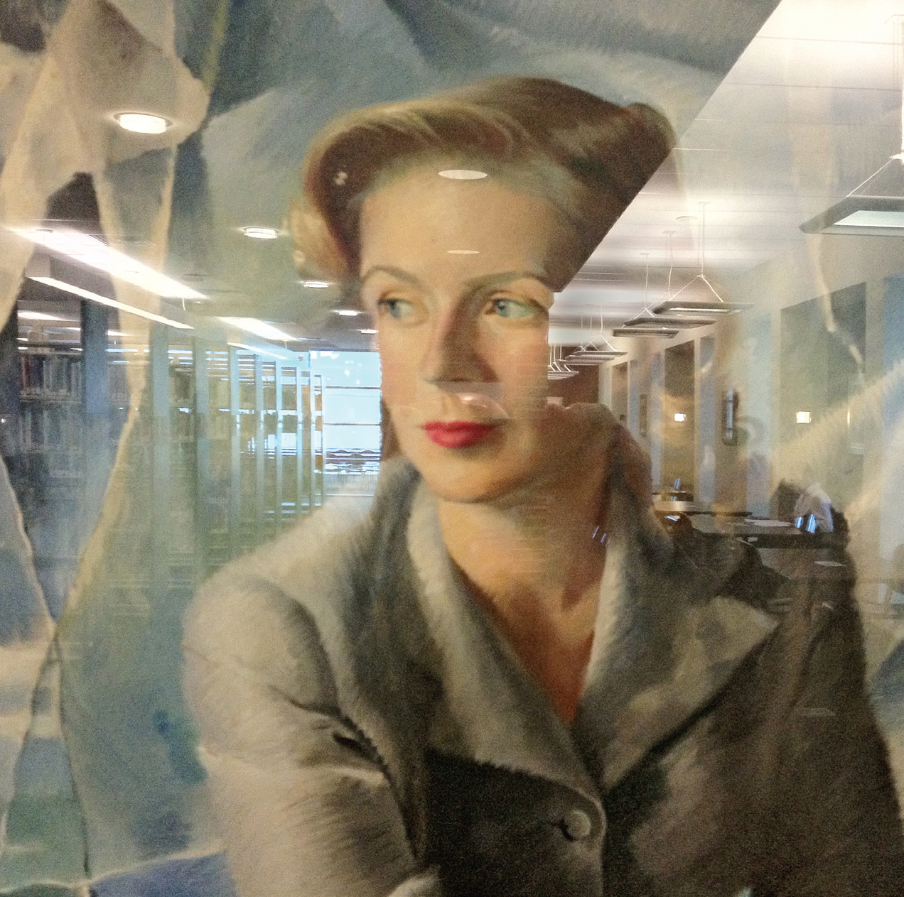
Reflections

Slide 32
Lessons Learned
Timeframe – larger and longer effort
Project planning
Managing volunteers and artists
Costs / real and hidden
Alternative strategies
Opportunities and Challenges

Slide 33
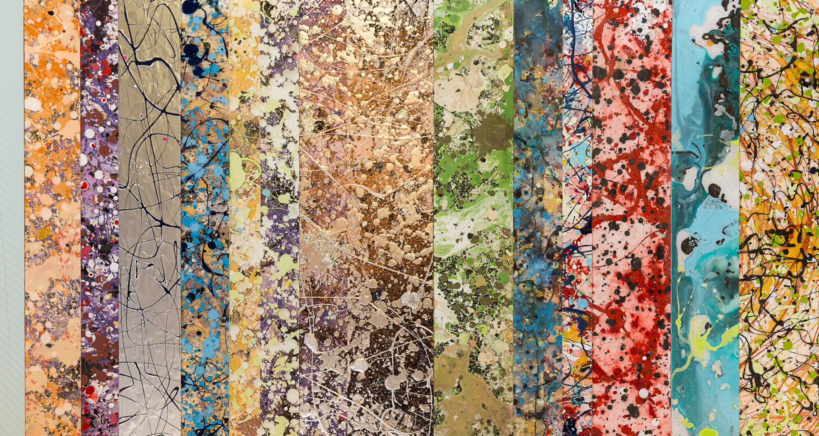

Slide 34
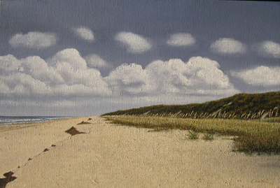

Slide 35
For More Information
http://www.unf.edu/library
http://libguides.unf.edu/artinthelibrary
shirley.hallblade@unf.edu
c.levine@unf.edu

